Slide 1
Java For Web
Gitlab + Intellij IDEA

Slide 2

Register on Gitlab.com
Go to https://gitlab.com
Register using your Full Name (ex. Oleksandr Kucher)
Go to https://gitlab.com/profile
Upload your photo (same as for slack) as avatar

Slide 3
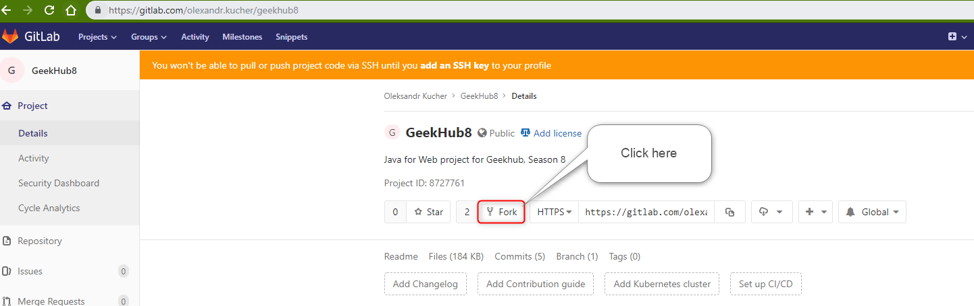
Fork GeekHub8 repository
Login to https://gitlab.com
Go to https://gitlab.com/olexandr.kucher/geekhub8
Click “Fork “ button
Select your user as namespace to fork the project

Slide 4
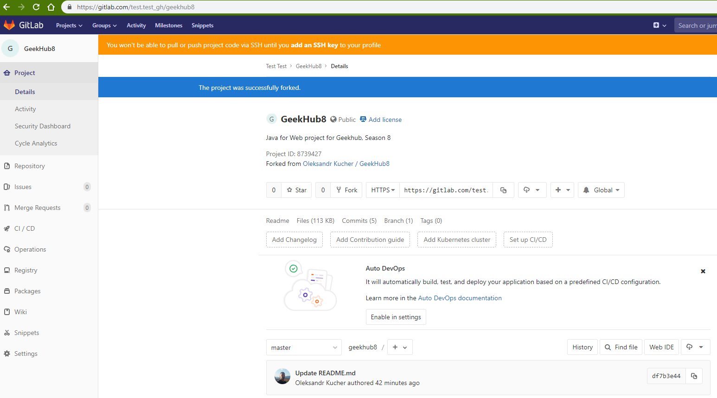
Fork GeekHub8 repository

Slide 5
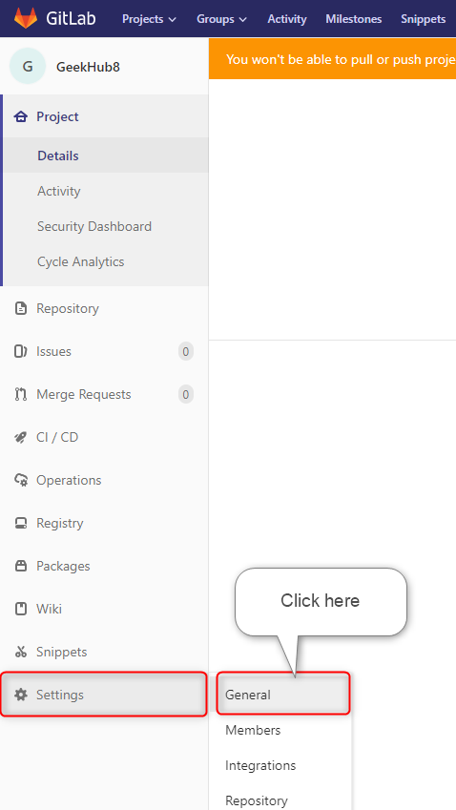
Fork GeekHub8 repository
Click “Setting” -> “General” on the opened page in sidebar menu

Slide 6
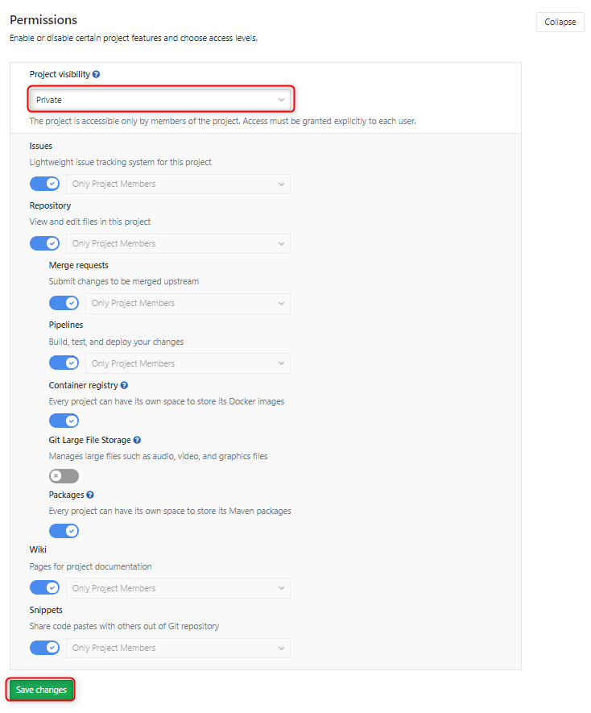
Fork GeekHub8 repository
Expand “Permissions” section
Change “Project visibility” to “Private”
Click “Save changes” button

Slide 7
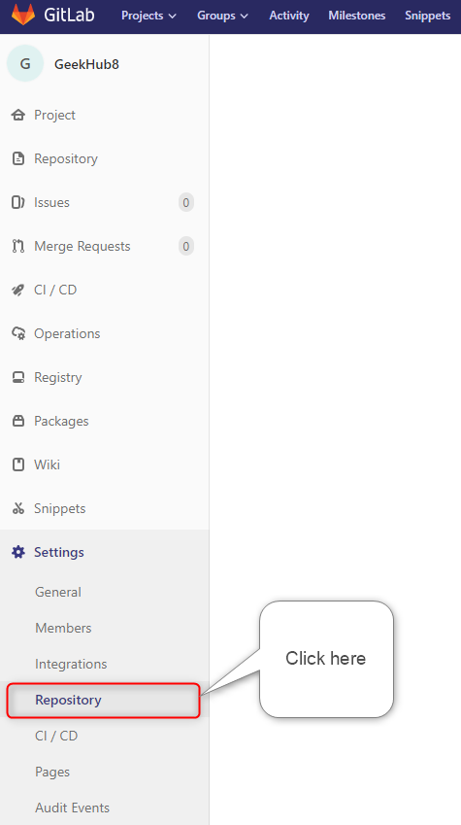
Fork GeekHub8 repository
Click “Setting” -> “Repository” in sidebar menu

Slide 8
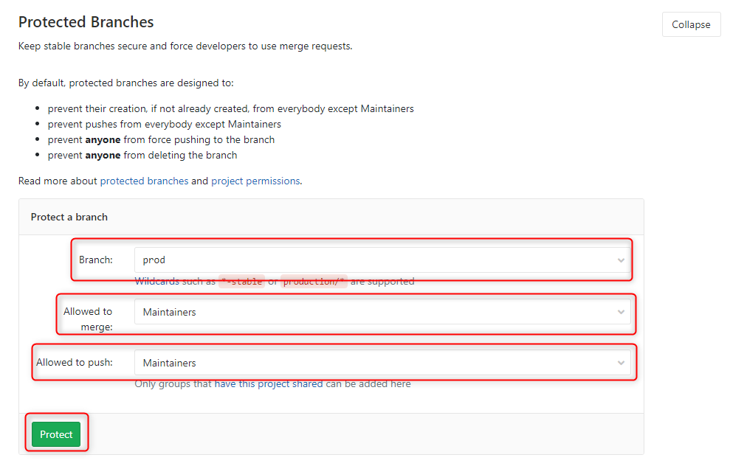
Fork GeekHub8 repository
Expand “Protected Branches” section
Choose branch prod (if prod branch is missing – create and push it into repository)
Choose Maintainers as Allowed to merge and Allowed to push
Click “Protect” button

Slide 9
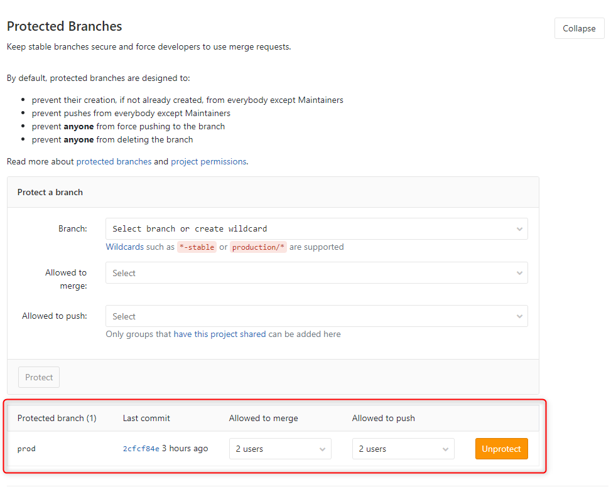
Fork GeekHub8 repository
Expand “Protected Branches” section
Verify that only one protected branch exists in your repository

Slide 10
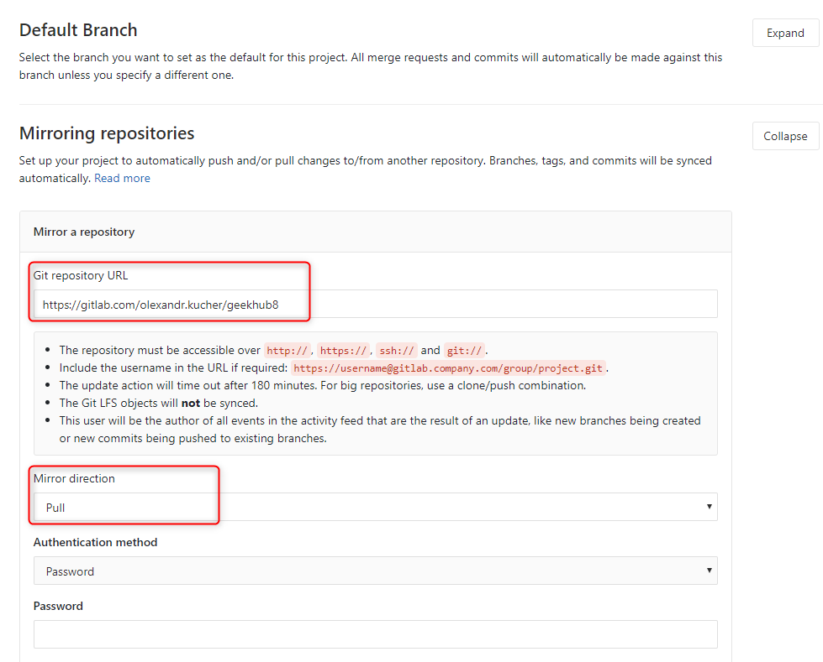
Fork GeekHub8 repository
Expand “Mirroring repositories” section
Paste or type https://gitlab.com/olexandr.kucher/geekhub8 into “Git repository URL” field
Choose “Pull” as “Mirror direction”

Slide 11
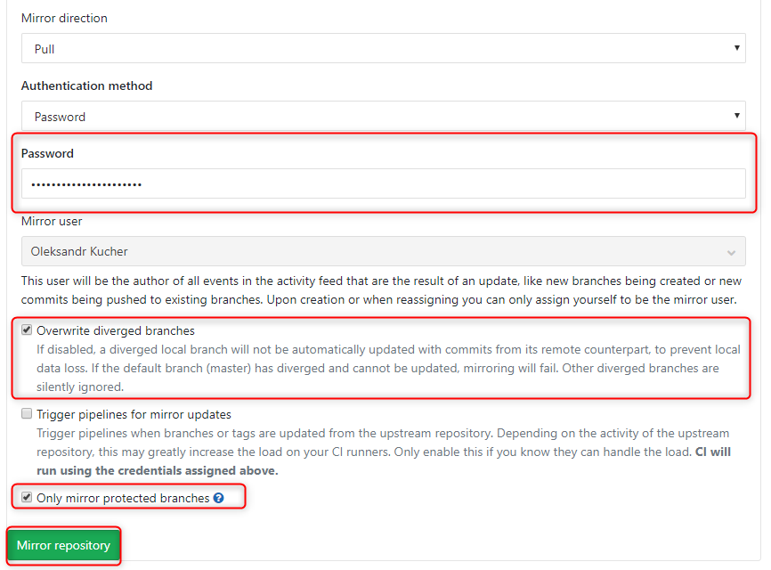
Fork GeekHub8 repository
Type your password to approve the action
Check “Overwrite diverged branches”
Check “Only mirror protected branches”
Click “Save changes” button

Slide 12
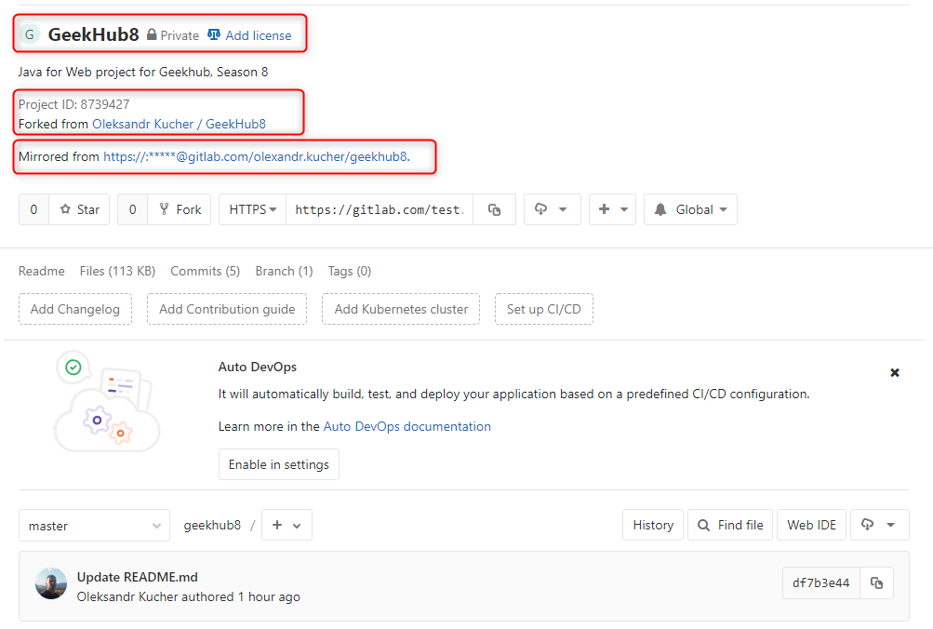
Fork GeekHub8 repository
Click “Project” -> “Details” in sidebar menu
Verify that all options in your repository are the same as on the screenshot

Slide 13
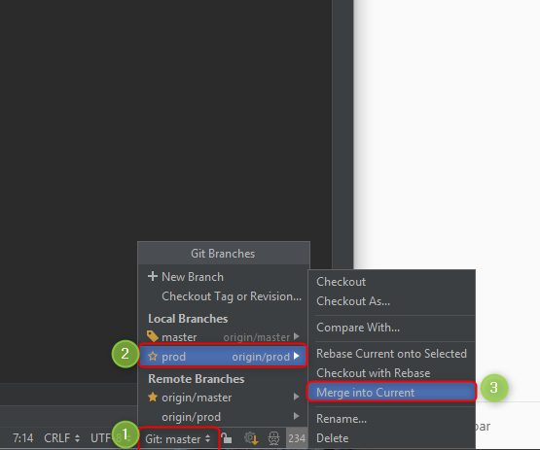
Fork GeekHub8 repository
prod branch will be mirrored from original repository
All changed done in this branch will be removed by mirroring mechanism
You should commit and push into master branch
To get updates from original repository in your master branch you should merge prod into master manually using IDEA or git command line

Slide 14
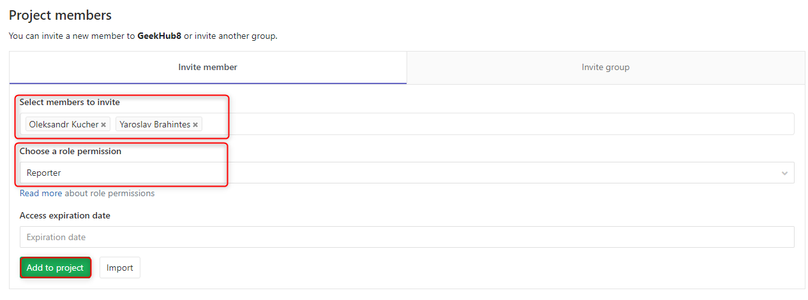
Fork GeekHub8 repository
Click “Settings” -> “Members” in sidebar menu
Choose olexandr.kucher and y.brahinets as Reporter
Click “Add to project”

Slide 15
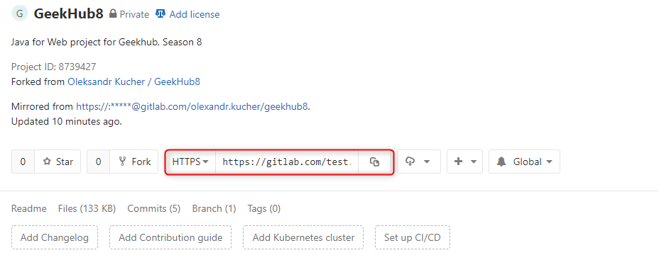
Import project into IDEA
Click “Project” -> “Details” in sidebar menu
Choose HTTPS type of link
Copy link to your repository

Slide 16
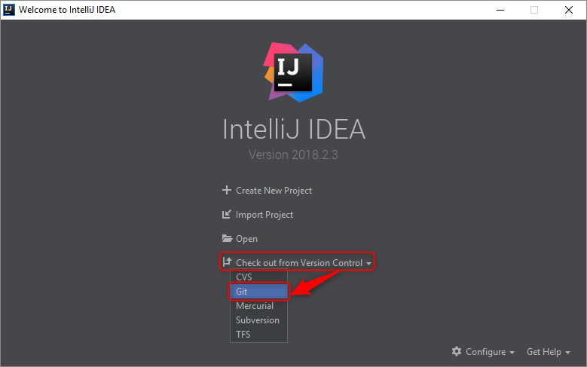
Import project into IDEA
Open Intellij IDEA
Choose “Check out from Version Control”
Choose “Git”

Slide 17
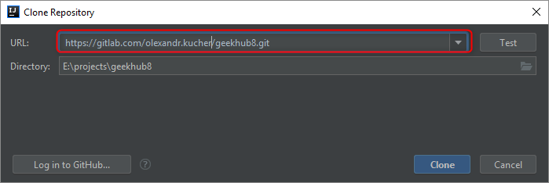
Import project into IDEA
Paste copied link of repository into just opened window
Click “Clone”

Slide 18
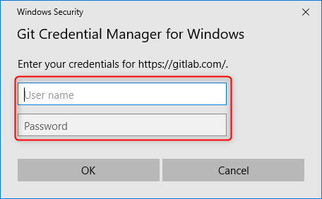
Import project into IDEA
Input your login and password for Gitlab.com if required

Slide 19
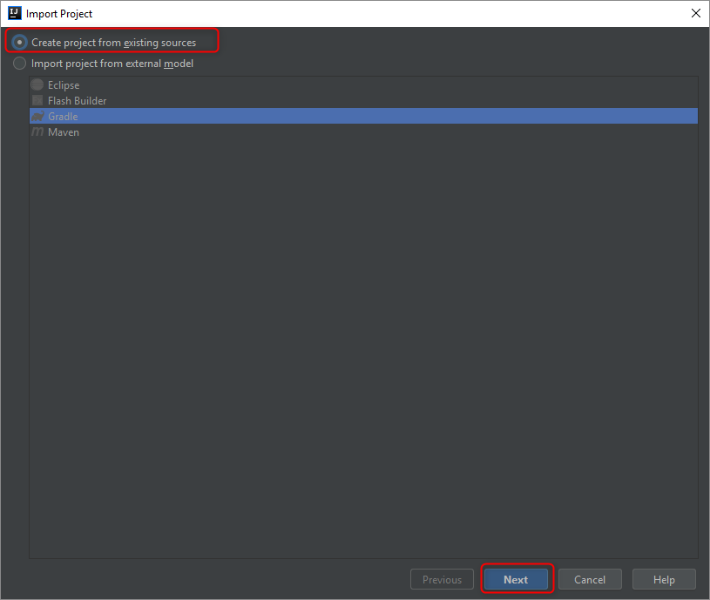
Import project into IDEA
Choose “Create project from existing source”
Click “Next”

Slide 20
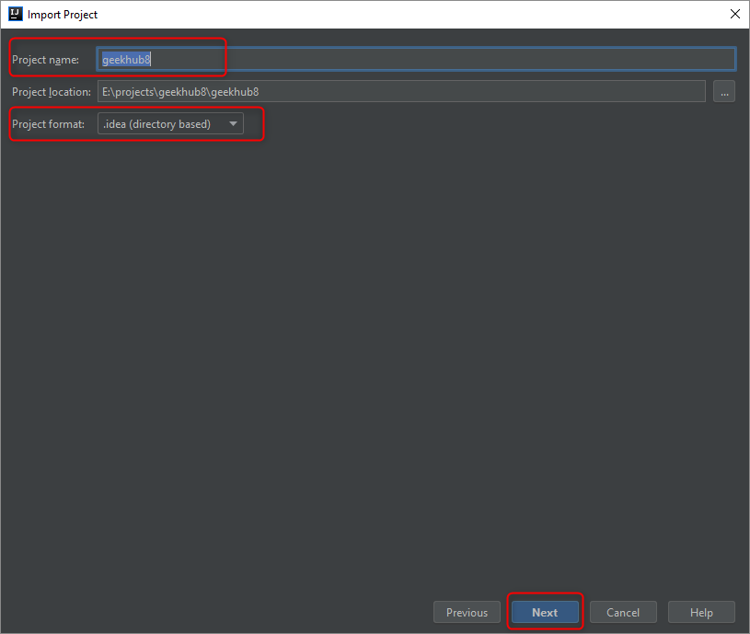
Import project into IDEA
Do not change “Project name”
Use default “Project format”: .idea
Click “Next”
Click “Next”
Click “Finish”

Slide 21
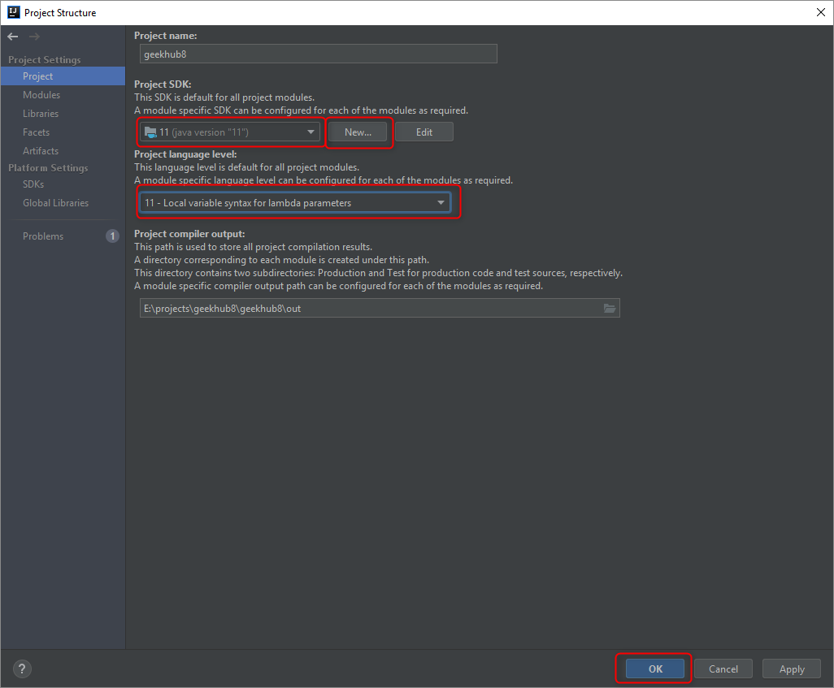
Import project into IDEA
Choose your project and press “Ctrl+Enter”
Choose “Project” tab
Add new JDK for IDEA by clicking “New” button, if required
Choose JDK 11 for your project
Choose “Project language level”: 11 – Local variable…
Click “OK”

Slide 22
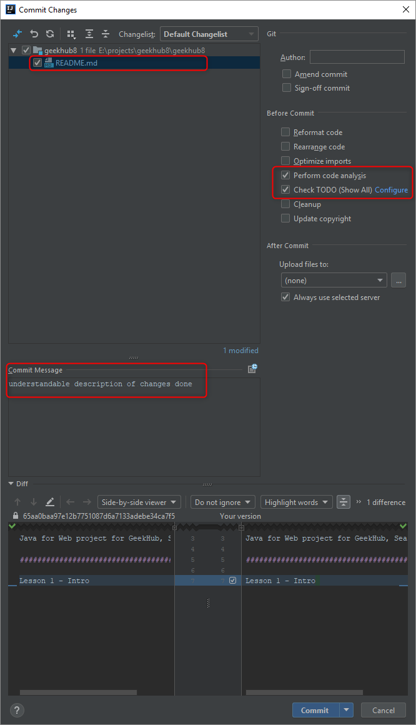
First Commit and Push to Git
You have made some changes, it’s time to commit and push
Press “Ctrl+K” to make commit
Choose files that should be committed
Type understandable and informative “Commit Message”
Check checkboxes: “Perform code analysis” and “Check TODO”
Click “Commit”

Slide 23
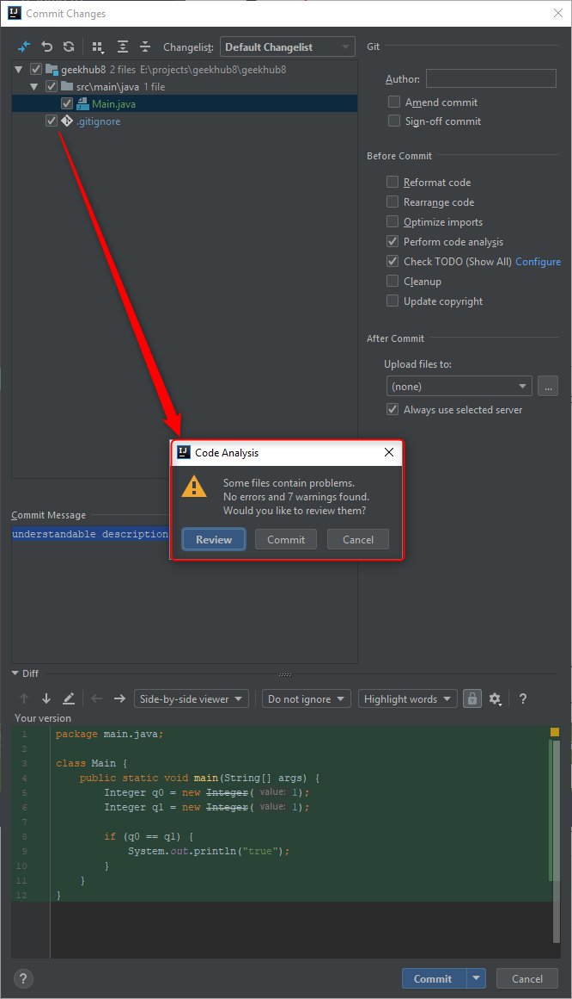
First Commit and Push to Git
Do not commit anything if you got some error or warning message

Slide 24
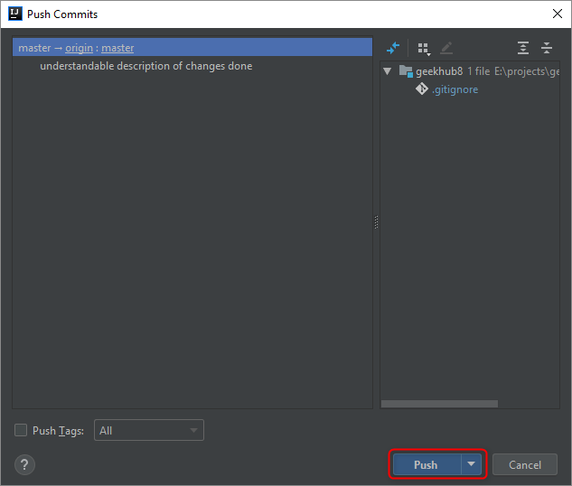
First Commit and Push to Git
Press “Ctrl+Shift+K” to push changes to remote repository
Click “Push”

Slide 25
Literature
https://git-scm.com/book/en/v2
https://try.github.io
https://gitlab.com/help
https://about.gitlab.com/2016/12/01/how-to-keep-your-fork-up-to-date-with-its-origin

